Slide 1
FOOD SECURITY IN INDIA
Introduction
What is food security?
Why food security?
Who are in food insecure?
Food security in India
What is buffer stock
What is PD system
Current status of PDS system

Slide 2
What is food security?
Food security means something more than getting two square meals.
Food security has following dimension
Availability
Affordability
Accessibility
Production of sufficient food with in the country
Imports and previous year stock
Everyone have enough money to buy sufficient , safe and nutritious food.
Food is within the reach of every person.

Slide 3
Food security is ensured in a country in three way .
1. If enough food is available for all the persons
2. All persons have the capacity (afford)to buy food of acceptable quality.
3. There is no barrier on access to food.

Slide 4
Why food security?
Population require food for survival
Most of the time the poorest section of the society might be food insecure
But Many became food insecure during natural calamities
Therefore food security must be a priority.

Slide 5
How food security is affected during a calamity?
Production of food grains decreases
It creates Shortage of food
Therefore prices goes up
some people cannot afford to buy food
This may lead to a situation of starvation .
Natural calamity

Slide 6
Question hour
1. What is food security?
2. What are……….. Dimensions of food security?
3. How food security is ensured in a country?
4. Why food security?
5. How food security is affected during a calamity?

Slide 7
What is famine?
If any calamities happens in a large area in a longer period of time.
It may causes a situation of starvation.
A massive starvation might take a turn of famine.
Calamities large area long period of time causes starvation turn in to famine.

Slide 8
How is famine characterised?
A famine is characterised by widespread deaths due to starvation.
Epidemics caused by forced use of contaminated water or decaying food
Loss of body resistance due to weakening from starvation.

Slide 9
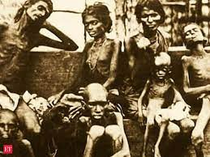
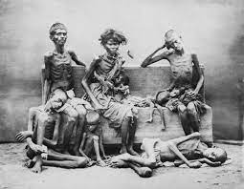
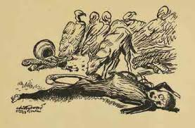
BENGAL FAMINE
The worst affected groups are:
The agricultural labourers, fishermen,transport workers, Landless people, traditional artisans,petty self employed, ill paid working groups, casual labourers and seasonal labourers.

Slide 10
GROUP ACTIVITY
MAKE AN DOCUMENTARY ABOUT BENGAL FAMINE

Slide 11
Today the situation is normal . Then why do we require food security?
Nothing like the Bengal famine has happened again.
But even today the places like Kalahandi and Kashipur in orissa facing famine - this condition is there in long years .
During the recent years some starvation death also reported in Baran district of Rajasthan, Palamu district of Jharkhand and many other remote areas.
Therefore food security is needed in a country to ensure food at all times.

Slide 12
Who are food insecure?
It depends on the situation.
Social composition(social groups) along with - inability to buy food also plays a role in food insecurity
SCs, STs,some sections of the OBCs
People affected by natural disaster,
People those who migrates in search of work
Pregnant and nursing mothers and
Small children are food insecure.
We have two case studies
Story of Ramu (example of rural food insecure)
Story of Ahmad(urban food insecure)

Slide 13
According to National Health and Family Survey (NHFS) 1998 -99 , the number of such women and children is approximately 11 cr.
Current scenario is, it declined by 38 to 36%

Slide 14
Food insecure states in India
States like parts in UP.,Bihar,
jharkhand, Orissa, West Bengal, Chhattisgarh,part of Madhya Pradesh and Maharashtra.
Food insecure people are largely living in some regions of the country.
Economically backward states with high incidence of poverty
Tribal and remote areas
Regions more prone to natural disasters etc.

Slide 15
Another aspect indicating food insecurity.
Is not just an expression of poverty.
To attaining food security will eliminate current
hunger and reduce the risk of future hunger.
HUNGER

Slide 16
HUNGER
Chronic hunger and
Seasonal hunger

Slide 17
Chronic hunger
Chronic hunger is a consequence of diets.
persistently(continuously) inadequate in quantity and quality.
Poor people suffer from chronic hunger because of their very low income
They cant buy food even for their survival.

Slide 18
Seasonal hunger
Seasonal hunger is related to cycles of food growing and harvesting.
This is prevalent in rural areas because of the seasonal nature of agricultural activities.
In urban areas because of casual labourers.
During the rainy season casual construction labourers will get less work.
when a person is unable to get work for the entire year will face this type of hunger.

Slide 19
The percentage of seasonal and chronic hunger was declined in India year by year.
Since independence India is aiming at self sufficiency in food grains
After independence, many measures had been adopted to gain self-sufficiency in food grains. India adopted a new approach in agriculture like the 'Green Revolution' to amplify the production of wheat and rice.

Slide 20
Food grains production was increased . many states recorded significant production in wheat later rice also.
Indira Gandhi former Prime Minister of India officially recorded the improvement of green revolution in agriculture by releasing a special stamp entitled 'Wheat Revolution' in July 1968

Slide 21
FOOD SECURITY IN INDIA
In the early 1970 s the country has avoided famine even during adverse weather condition because of the advent of Green Revolution.

